Slide 1
Server-side Web Development
Sessions and Cookies

Slide 2
Question
Imagine you have a form which gets the user name and other information
The next page asks for other information – say credit card details.
How do you ensure that all of that data is available on the controller called by the second page? (without making the user re-enter their name etc?)
Assumption: we can’t change the 2 forms!

Slide 3
Hidden Data Fields
Suppose a user enters data over 2 forms.
Also suppose we want to share some data from the first form to the second.
It is possible to return the data from the first form to the second form but hide it.
And when the second form is submitted, the Servlet or JSP accessing the form can access all the data

Slide 4
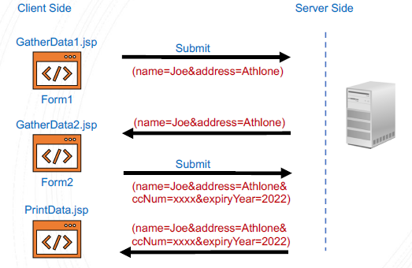
Hidden Data Fields

Slide 5
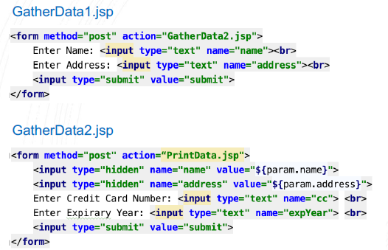
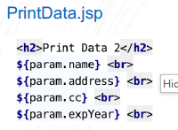
Hidden Data Fields

Slide 6
Try it!

Slide 7
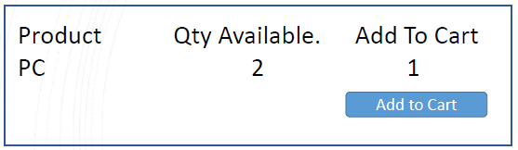
Hidden Data Fields (Again)
Suppose we have a list of products
With an add to cart button below

Slide 8
Hidden Data Fields
In order to add the product to the cart we need to identify the product.
Often this is done using an id.
So the AddToCartServlet needs the id of the product.
Normally this is not shown to the customer but would be a hidden field in the form.
The id or product code field of things is often hidden in this way.

Slide 9
HTTP Session Scope
Often used to support login.
In Servlet
HttpSession session = request.getSession();
session.setAttribute(“user”, loggedInUser);
In JSP
Current user:
${sessionScope.user.name}
Sessions can be set to timeout after a specific period.

Slide 10
Try it!
It is easy to re-implement the above hidden fields example using the HttpSession object.
Simply add each field value to the session object.
Two ways of doing this:
1. Use a JSP scriptlet
I know I said they were deprecated.!
Use of scripts should be very controlled !!!
These are enclosed in <% %>
2. Use JSP core tag c:set

Slide 11


Try it!
Using Scriptlets <% %>
Using c:set preferred!!

Slide 12
Cookies in Servlets
Cookies are text data sent by Web Servers as part of the response to a client.
Depending on the maximum age (getMaxAge() and setMaxAge()) of the Cookie, the browser will store the cookie on the client machine (memory or disk) for a certain period of time.
All subsequent requests sent to a Web Server contain the Cookies that originated from that Web Server.
A Cookie is simply a name/value pair.

Slide 13
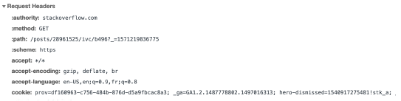
Cookies in Servlets
Cookies are sent as part of the header information of both requests and responses

Slide 14

Setting a Cookie in Servlets
To set the value of a cookie
Use the setMaxAge() method supplying an integer that specifies the maximum age of the cookie in seconds.
If the age is set to 0 then the cookie should be discarded immediately.

Slide 15
Reading values from a Cookie in Servlets
To obtain the value of any Cookies use
Cookie[] cookies = request.getCookies();
It is then necessary to iterate through the array to check for the Cookie you want.
Use the methods getName() and getValue().
Other cookies seem to be set when using Netbeans!

Slide 16
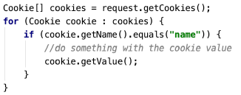
Reading values from a Cookie in Servlets

Slide 17
Try it!
Write two Servlets.
The first should check to see if the customer is known (Cookie).
If the Customer is known, the first Servlet should welcome the user back.
If the Customer is not known it should generate a form that asks the user for some information.
The second Servlet should put that information in a Cookie.
<jsp:include page=″servletName.java″ >

